Slide 1
1) THIS IS MY ACTUAL DAILY ROUTINE:
I get up at 9 o’clock, I have breakfast and I get dressed. Then, from 10 o’clock, I have two online lessons and a little break among them. At 1 o’clock p.m. I have lunch and then I watch tv series with my brother. I have my homework and I make video calls with my best friends at 3 p.m. o’clock. I have a sport at half past seven p.m. with my family. I have dinner at 8 p.m. and I watch a film of “Avengers” at 9 o’clock p.m. I go to sleep at half past 11 p.m.

Slide 2
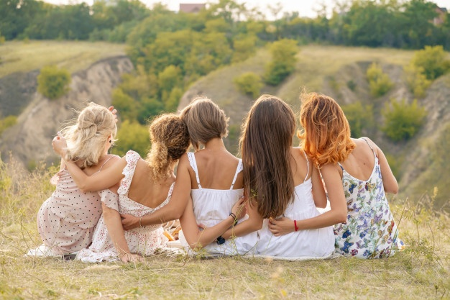
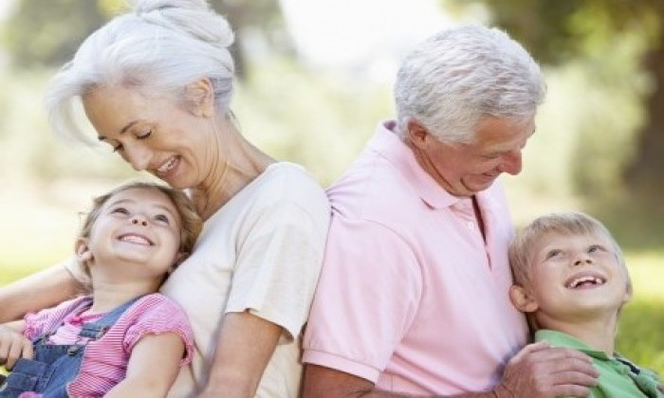
2) OF MY PREVIOUS DAILY ROUTINE I MISS:
*My friends
*My grandparents and uncles
*My cousins Lorenzo and Federico
*The house of my grandparents

Slide 3
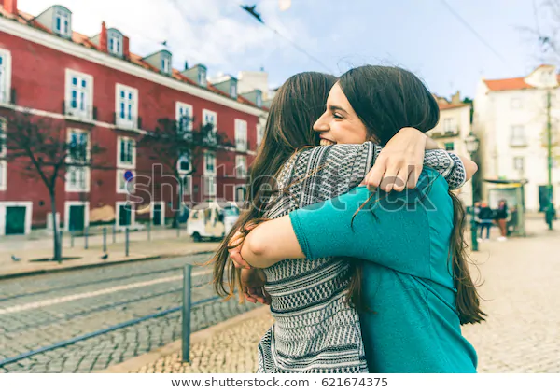
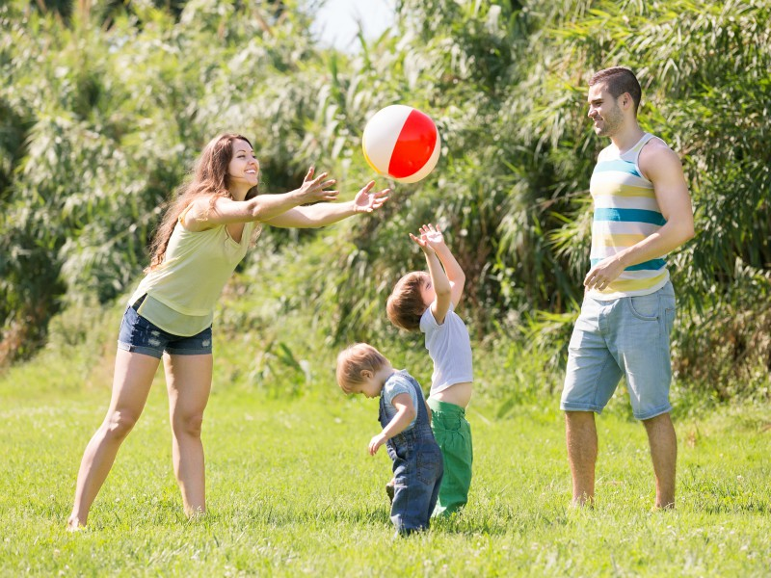
3) ON MY FIRST DAY OUT I WANT TO:
> visit my grandparents
> meet and hug my friends
> go to the park

