Slide 1
MY ACTUAL DAILY ROUTINE

Slide 2
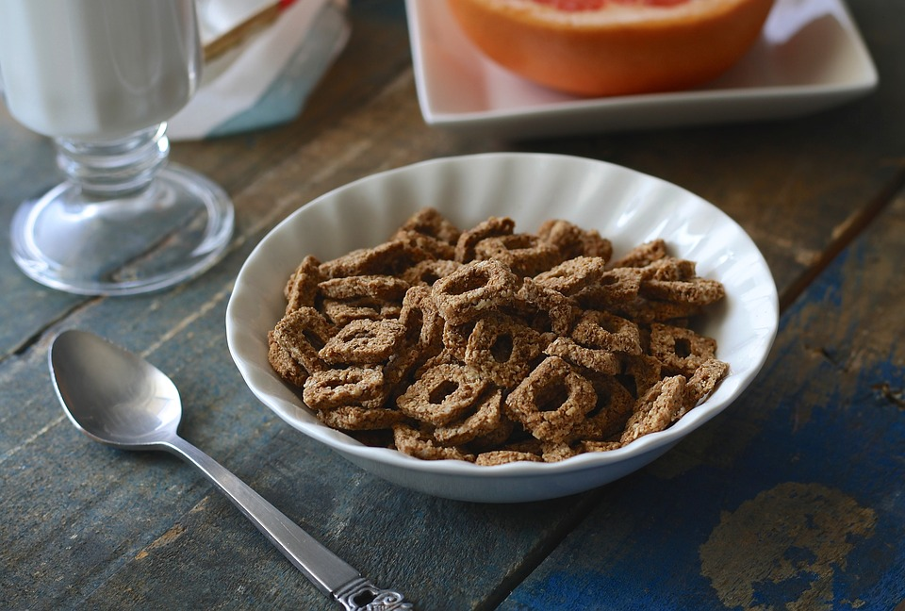
I GET UP AT HALF PAST EIGHT;
I PRACTICE SPORT AT TWENTY-FIVE TO NINE;
I HAVE BREAKFAST AT TWENTY TO TEN;
I HAVE ONLINE LESSONS AT TEN 0’ CLOCK AND ELEVEN O’ CLOCK;
I DO MY HOMEWORK AT HALF PAST ELEVEN;
I HAVE A SHOWER AT TWELVE 0’ CLOCK;
I HAVE LUNCH AT ONE 0’ CLOCK;
I DO MY HOMEWORK AT HALF PAST TWO;
I HAVE A SNACK AT FOUR 0’ CLOCK;
I DO SPORT AT FIVE 0’ CLOCK;
I HAVE DINNER AT HALF PAST SEVEN;
I WATCH TV AT HALF PAST EIGHT;
I GO TO BED AT HALF PAST TEN.

Slide 3
OF MY PREVIOUS DAILY ROUTINE I MISS

Slide 4
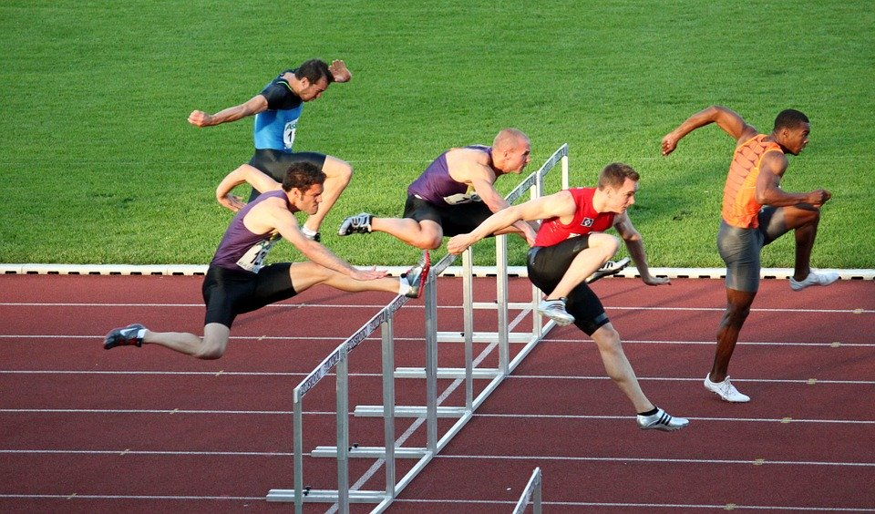
THE SPORT(ATHLETICS);
MEETING MY FRIENDS;
MY BEST FRIENDS(ELBA AND BUDASSI);
MY COUSINS.

Slide 5
ON MY FIRST DAY OUT I WANT TO

Slide 6
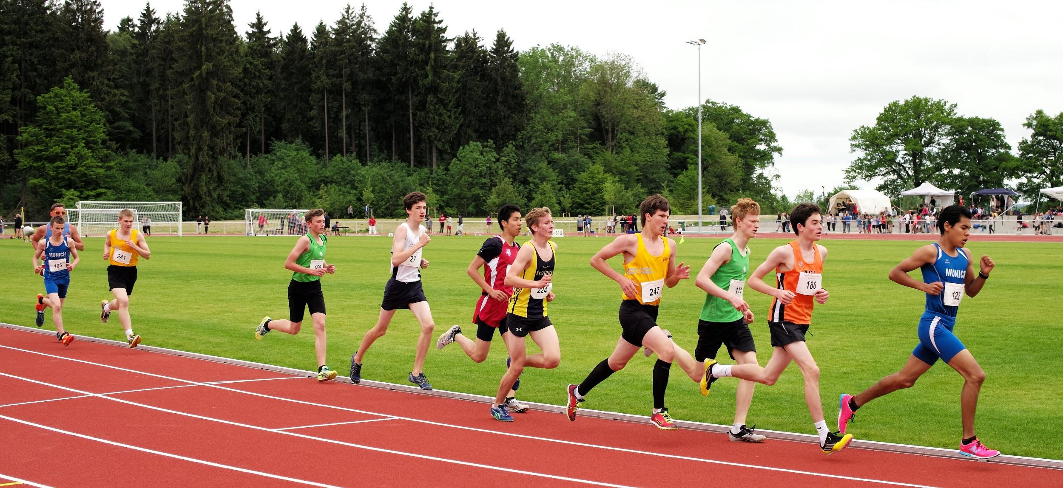
GOING OUT;
MEETING MY FRIENDS;
GOING TO ATHLETICS;
VISITING MY COUSINS AND MY BEST FRIENDS;

Slide 7
THANKS FOR THE ATTENTION

